Slide 1
Predicting the energy output of wind turbine based on weather condition
DONE BY:
NAVEEN KUMAR.M
VIGNESH.R
VETRIVELMURUGAN
VENKATARAJAN

Slide 2

ABSTRACT
Wind energy plays an increasing role in the supply of energy world-wide. The energy output of a wind farm is highly dependent on the weather conditions present as its site. If the output can be predicted more accurately , energy suppliers can coordinate the collaborative production of different energy sources more efficiently to avoid costly overproduction . We predict energy prediction based on weather data and analyse the important parameters as well as their correlation on the energy output.

Slide 3
LITERATURE SURVEY EXISTING PROBLEM
There exist a number of technological, environmental and political challenges linked to supplementing existing electricity generation capacities with wind energy. Here , mathematicians and statisticians could make a substantial contribution at the interface of meteorology and decision-making, in connection with the generation of forecasts tailored to the various operational decision problems involved. Indeed, while wind energy may be seen as an environmentally friendly source of energy, full benefits from its usage can only be obtained if one is able to accommodate its variability and limited predictability. Based on a short presentation of its physical basics, the importance of considering wind power generation as a stochastic process is motivated. The conventional moving-average statistical models were proven to be less efficient in forecasting the wind energy, as the wind speed is inherently variable quantity.

Slide 4
Proposed Solution
Our approach was to use a time series forecasting model that would generate point forecasts of wind generation for the upcoming three days, for a wind turbine. We used publicly available historical weather data of a wind plant to train model and learn the changing weather patterns. We also used it to find the correlations among different weather attributes and their effect on energy output.
We have used a VAR (Vector Autoregressive) model, a multivariate time-series model to handle multiple time series of different weather attributes. We have presented our results in an Android application in user-friendly graphs and tables

Slide 5
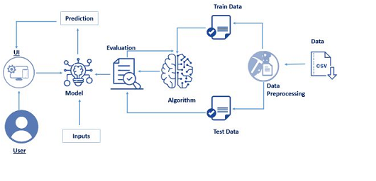
ARCHITECTURE DIAGRAM

Slide 6
PROJECT WORK FLOW
Data collected from Wind Form
Preprocessing Data - This process consists of data cleaning , data analysis and feature enginnering.
Model Development
UI/Dashboard Development

Slide 7
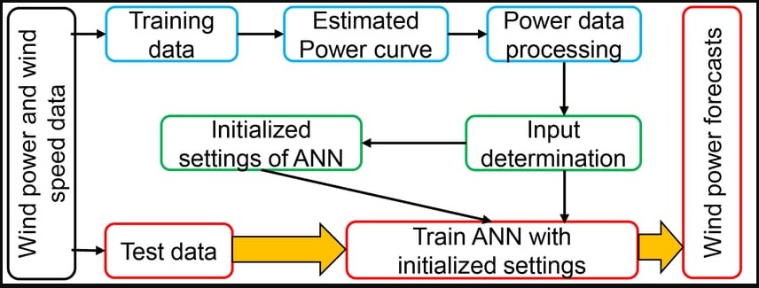

Slide 8
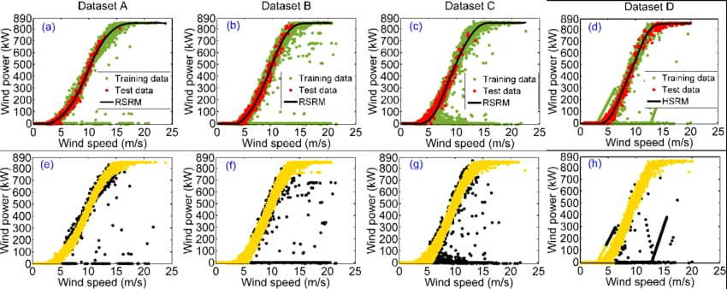
DATA SET FLOW

Slide 9
Advantages
The model not only uses a 3 year historical weather data but also saves in the updates of daily weather training itself everyday hence getting better every day.
Since the model uses a huge amount of data the results generated are accurate and reliable.
The model also helps in avoiding the damage to the turbine when the wind speed is below cut-in speed or above cut-off speed as wind speed is forecasted in advance.
The interface is user friendly and easy to use and understand even to a person who has very little/no knowledge for the same.

Slide 10
Disadvantages
The unsteadiness and the turbulence of the wind may vary the wind speed predictions hence pose a threat to the wind turbine from cut-off speed
The power output does not take into consideration the power loses due to wire cables or other resistance offering components.
Wind gusts are not taken into the consideration while generating the predictions due to their unpredictability and lack of proper data.
The model generates theoretical power forecasts close enough to the active power, thus the results cannot be taken as accurate point forecasts of the power values.

Slide 11
Applications
This model helps the farm to plan ahead of time for the unit commitments to the power grid. Hence relaxing the conventional sources of energy
It also helps in scheduling and dispatch by system operators, and maximize profit by electricity traders
This model can further be used to analyze suitability of a location to setup a wind farm. Hence increasing the market of wind power.
This model can also be developed to provide the wind direction hence enabling the farm rotate the turbines in given direction to get better output.

Slide 12
Future Scope
The results are quite promising, but there is still a room for further improvement. With the availability of daily wind turbine output data for a minimum of 3-4 years, we can use neural networks to understand the mapping of the calculated power into the active power due to the weather variables.
Wind power generation is directly linked to weather conditions and thus the first aspect of wind power forecasting is the prediction of future values of the necessary weather variables at the level of the wind farm. However, even by better understanding and modelling both the meteorological and power conversion processes, there will always be an inherent and irreducible uncertainty in every prediction.
This internal uncertainty corresponds to the incomplete knowledge one has of the processes that influence future events. Thus, rather than generating point forecasts of power outputs for consecutive hours, we should predict maximum power outputs for a day.

